Slide 1
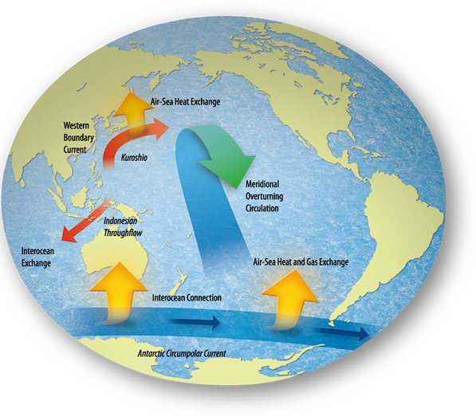
Distributing the Heat

Slide 2
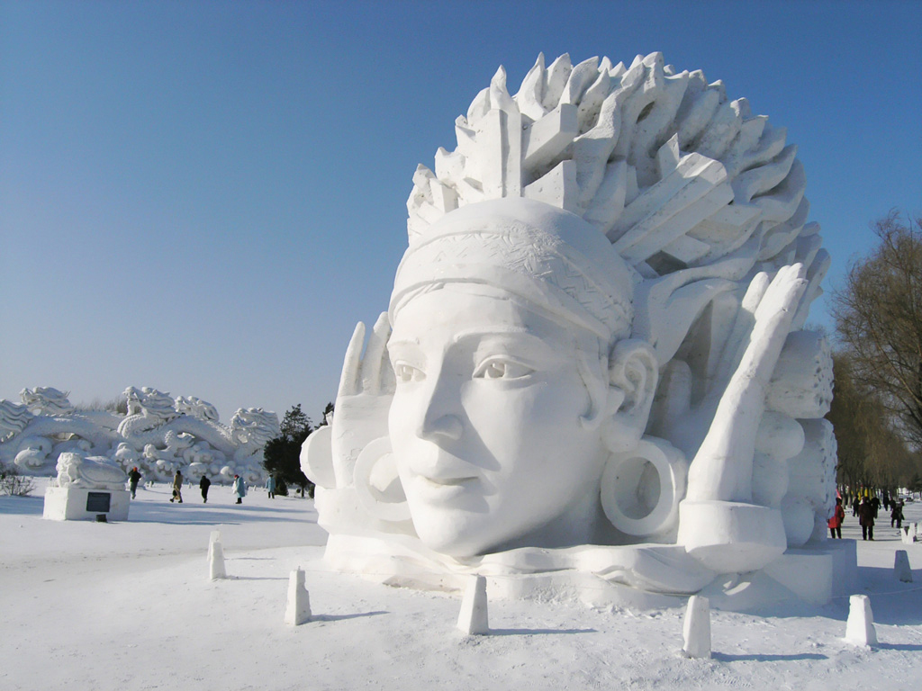
Every year, Prince Albert hosts a winter carnival where you can see really “cool” snow sculptures. During Prince Albert’s winter, ice sculptures are usually able to remain frozen. Meanwhile, only approximately 1700 km away, Vancouver’s winters are mild—too mild to maintain snow sculptures over weeks at a time.
Why?

Slide 3
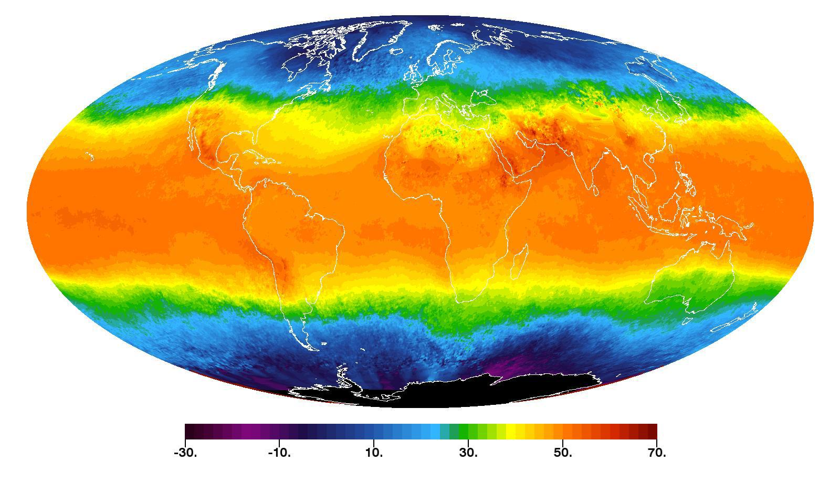
The earth’s land & water absorb energy at different rates
The earth is therefore unevenly heated

Slide 4
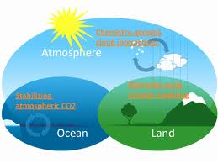
The Earth’s Climate System needs to distribute thermal energy from areas that receive a lot to areas that receive little
Systems affecting heat distribution:
  The Hydrosphere
  The Atmosphere
  The Lithosphere

Slide 5
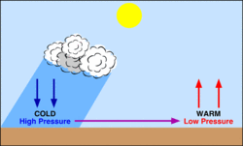
1. THE ATMOSPHERE
Atmospheric Pressure
= pressure exerted by the mass of air on Earth’s surface.
  Area of Low Pressure
  Warm air expands, becomes
  less dense, rises from Earth’s surface
  Area of High Pressure
  Cold air contracts, becomes denser, descends to Earth’s surface

Slide 6
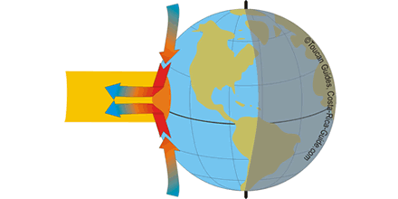
Convection Currents
They move thermal energy from the equator towards the North and South Poles
Due to the Sun’s intense rays, the
air at the equator heats up rapidly,
becomes less dense and rises
Once the warm air reaches
troposphere, it spreads towards
the poles and cools down
The cooler air sinks back to earth,
pushing the warm air into the
atmosphere
These convection currents are one of the main ways that energy is transported in the atmosphere

Slide 7
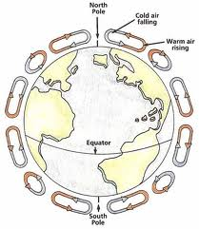
Convection Cells
Cold air descends at 3 separate latitudes:
30º, 60º and the Poles
At the equator, warm air rises and loses its moisture.
At 30◦, dry air descends = deserts occur at 30◦ latitude
around the world.
The movement of cool air from these areas of high pressure to areas of low pressure is Wind.

Slide 8
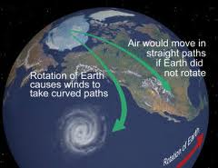
Coriolis Effect
Earth is constantly rotating and the atmosphere rotates with it
The Earth rotates faster at the Equator than the poles.
This uneven rotation causes the convection cells (and anything else in the atmosphere like airplanes, missiles, space shuttles) to veer to the sideways!
This tendency is called
the Coriolis effect.
Coriolis effect

Slide 9
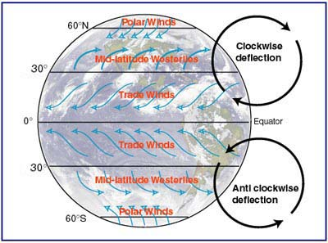
Patterns of Wind Movement
There are 4 main wind belts on Earth.
Winds are names based on the direction they originate from
Due to the coriolis effect, the Trade Winds move from the northeast to the west in the Northern hemisphere, and from southeast to the west in the Southern hemisphere.
The Westerlies move from the west, towards the east.
global wind patterns

Slide 10
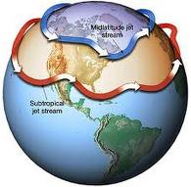
Jet Streams
Currents of extremely fast-moving air about 10-15 km above Earth’s surface are called Jet Streams.
Jet Streams form at the boundaries of cold and warm air.
The intense winds within jet streams influence precipitation and thunderstorms.

Slide 13
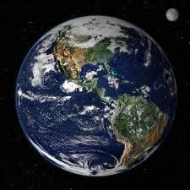
2. The Hydrosphere
Earth has been given the nickname “The Blue Planet”. This is because Earth’s surface is covered with 70% water.
The hydrosphere is made up of water from the Earth’s oceans, rivers, streams, lakes, ground water, glaciers and water in the atmosphere.
Water plays a very important role in the movement of energy through the biosphere.

Slide 14
The Hydrologic Cycle
Earth’s hydrosphere undergoes a constant cycle involving transport and transformation called the water cycle.
The water cycle is one way that the climate system moves energy from one place to another
  The hydrologic cycle distributes water by evaporation, condensation & precipitation.
http://earthguide.ucsd.edu/earthguide/diagrams/watercycle/

Slide 15
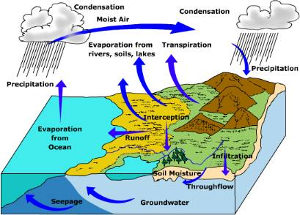
The Water Cycle
1. Heat from the sun causes water in
oceans & other water sources to
evaporate
2. Rising air currents cool the water
filled air forming clouds
(condensation)
3. Clouds release precipitation
(snow, rain, etc.)
4. Precipitation can runoff into bodies
of water or be absorbed
(groundwater)
5. Water is then able to evaporate
again
**NOTE: water can be stored in such areas as glaciers and groundwater (aquifers). Water may also be transpired from trees.

Slide 16
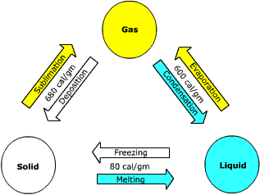
Energy Transfer in the Hydrologic Cycle
At various stages in the
hydrologic cycle, water
molecules undergo change
in state, from solid to liquid
to vapour, and back again.
Because of water’s high specific heat capacity it takes a lot of energy to change its temperature or phase.

Slide 17
Energy is absorbed when water evaporates from lakes and oceans.
Energy is given off when water condenses into clouds in the atmosphere.
Because of these phase changes, the hydrologic cycle moves not only lots of water, but it moves vast amounts of thermal energy.

Slide 18
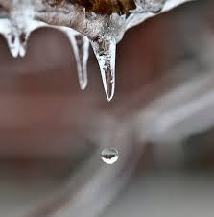
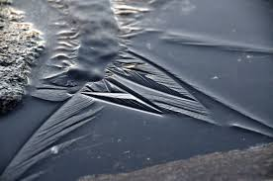
How do water’s phase changes influence climate?
In Spring, days become longer = more solar energy
Much of the Sun’s energy is used to melt the snow and ice so the air temperature does not rise as much as it would in their absence.
As winter sets in, shorter days = less solar energy and therefore less heat
However, liquid water releases heat as it freezes = less of a drop in air temperature.

Slide 19
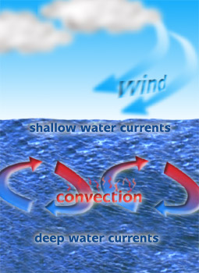
Oceans
Water has a low albedo and absorbs more than 90% of the solar energy striking it.
the energy absorbed by the oceans is distributed around the globe due convection currents, winds and topography.
thermohaline circulation

Slide 20
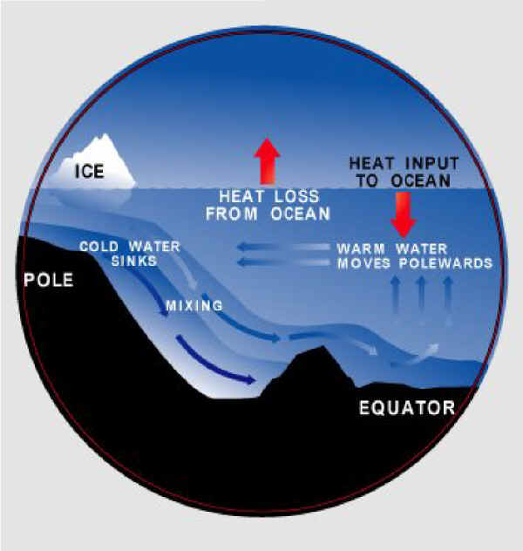
Thermohaline Circulation
Thermo means heat and haline means salt in Greek
Warmer water is less dense than colder water & a current is formed
when water is unevenly heated
The sun warms equatorial water starting convection currents
As water travels to the poles, it
gets colder and saltier
This denser, saltier water at the
poles sinks to the ocean floor
& warmer surface water from
the equator then flows to take
its place

Slide 21
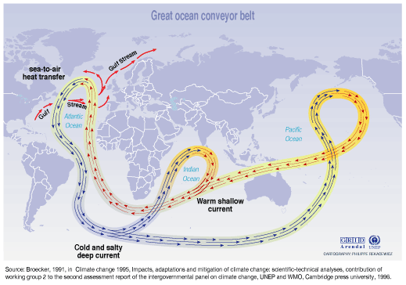
= giant rivers within the sea that act like “conveyor belts” transporting
the energy stored in water from warm parts to cold parts of Earth
Thermohaline Circulation

Slide 22
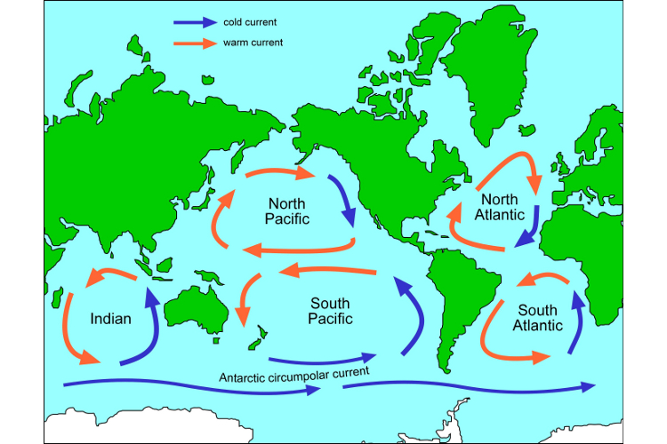
- these currents are started by surface winds
- their patterns of flow are affected by:
a) earth’s rotation = coriolis effect
b) shapes of the continents
Result = gyres: almost circular currents which flow clockwise in the Northern Hemisphere & counterclockwise in the Southern Hemisphere

Slide 23
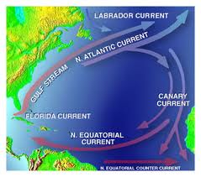
Surface Currents
Ocean currents have a strong effect on the climates of nearby land.
Warm ocean currents heat the air above them and when the air reaches land, it warms it and produces rain
Cold ocean currents cool the air above them and when this air reaches land, it cools the land and creates desert areas
The Gulf Stream is a large surface current that starts in the Caribbean and follows the coastline of the United States and Canada.
It transports warm water from the tropics to the eastern coast of North America and across to Europe.

Slide 24
El Nino and La Nina
El Niño is a disruption of the ocean-atmosphere system in the tropical Pacific that typically occurs every three to seven years.
During an El Niño year, the wind reverses direction over the South Pacific & flows eastward causing an increase in the sea-surface temperature
- result = heavy rains in South America & droughts in Asia &
Australia.
La Niña is the opposite of El Niño
An increase in the strength of the westward moving winds.
La Niña produces wetter than normal conditions in Australia and Asia while North America becomes warmer and drier.
el nino / la nina
Science Cast

Slide 25
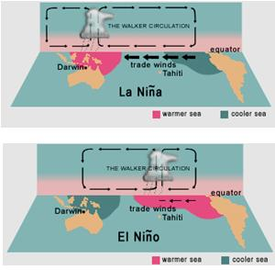

Slide 26
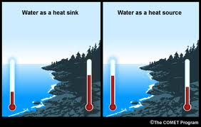
The Ocean as a Heat Sink
The ocean is an important heat sink because it can absorb more energy than air
It absorbs a great deal of solar radiation, keeping the region cooler during the day, and it slowly reradiates the heat at night
Areas around large bodies of water do not experience extreme weather changes like areas that are continental interiors
- i.e. British Columbia and Saskatchewan

Slide 27
3) The Lithosphere
The part of the climate system made up of solid rock, soil and minerals of Earth’s crust
It extends under the oceans
The Lithosphere absorbs higher-energy radiation from the sun, converts it into thermal energy and the emits energy back as lower-energy radiation
Sea and land breezes form as a result of the vastly different specific heat capacities of water and land. Water heats and cools at a slower rate than land. This results in a temperature differential between the two bodies.

Slide 28
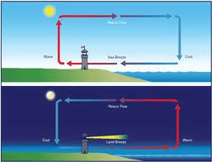
Sea Breeze vs Land Breeze
Daytime: land heats up faster than water, sets up convection current, air blows towards shore = “sea breeze”
Nighttime: water cools more slowly than land, air blows towards ocean = “land breeze”

Slide 29
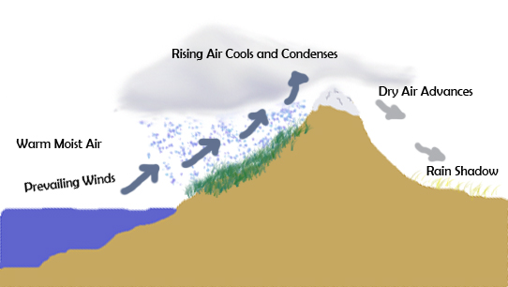
Land Formations
Land formations such as mountains affect climate zones by disrupting air flow over an area
Warm, moist air cools, condenses as it rises against the mountains resulting in precipitation on the windward side and a dry leeward side = the Rain Shadow Affect
i.e. Alberta & Saskatchewan are much drier than Vancouver

