Slide 1
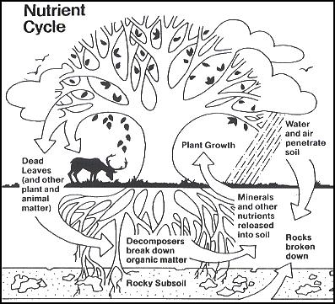
Introduction to Nutrient Cycles
Science 10

Slide 2
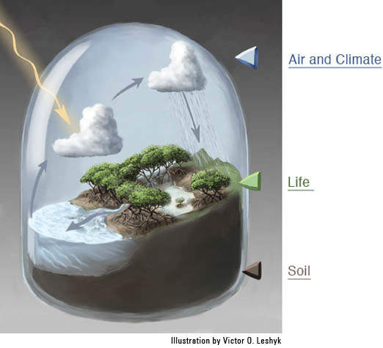
Introduction
The Earth is a ­­­closed system.
Energy enters and leaves via radiation but matter does not enter or leave earth.

Slide 3
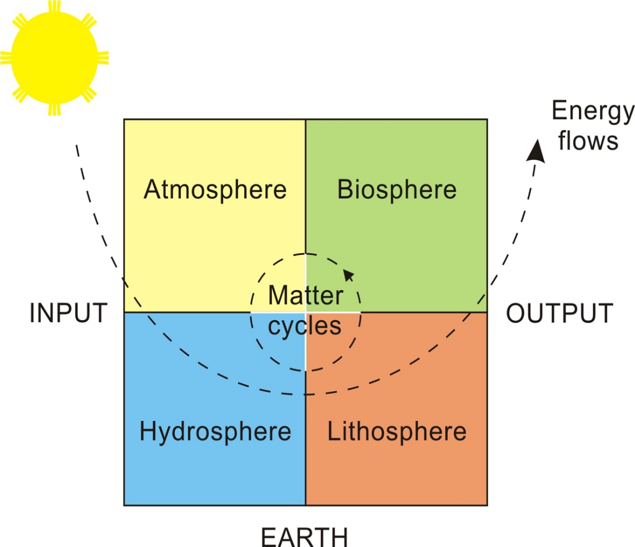
Introduction
In ecosystems, both energy and matter constantly circulate.
Energy flows through ecosystems while matter cycles.

Slide 4
Nutrient Cycles
A nutrient cycle is the movement and exchange of matter throughout an ecosystem.
A nutrient is any substance needed by an organism for proper growth, repair, and function (i.e. C, N, P, O).

Slide 5
Carbon Cycle
Carbon is found in all living matter.
Places that carbon is found are called stores or sinks.
Short-term Stores Long-term Stores
living things in water & on land - underground (oil, gas,
rotting tissue of plants/animals natural gas and coal)
atmosphere (air) - sedimentary rock
- ocean (dissolved in the water) (limestone)
- ocean floor (old shells)

Slide 6
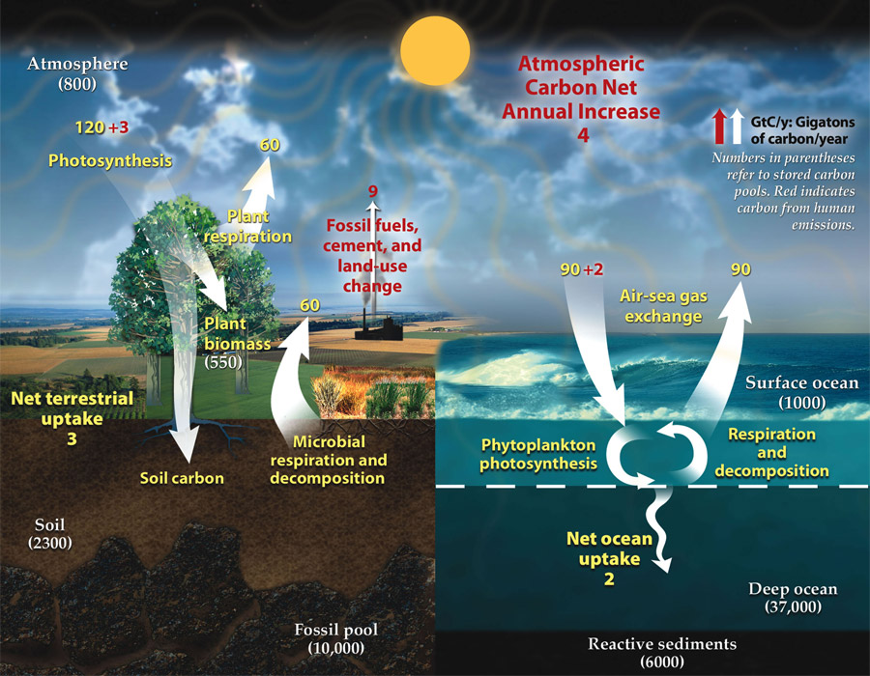
Carbon Cycle
1. Carbon moves from the atmosphere to plants and oceans.
In the atmosphere, carbon is in CO₂. Through photosynthesis, CO₂ is pulled from the air to make plant food.
CO₂ + H₂O + SOLAR →C₆H₁₂O₆ + O₂
NRG
The oceans soak up carbon from the atmosphere.

Slide 7
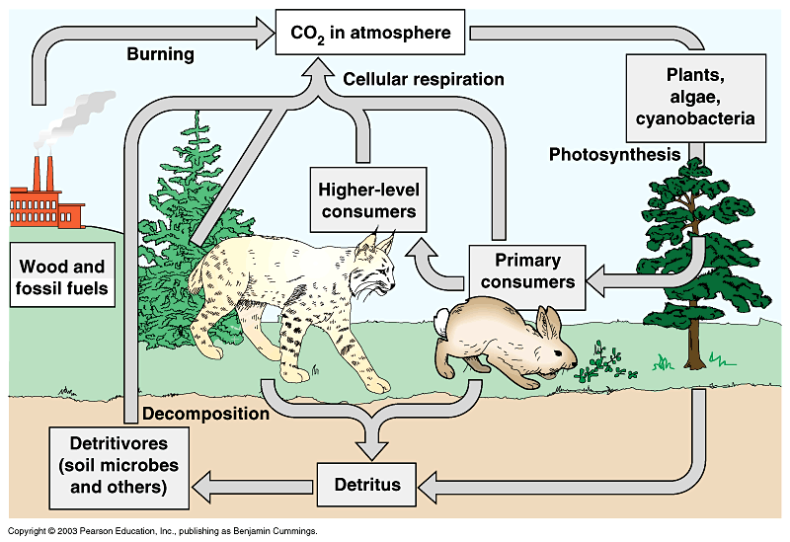
Carbon Cycle
2. Carbon moves from plants to animals.
Through food chains, the carbon in plants moves to higher level consumers.
3. Carbon moves from plants and animals to the ground.
When living things die, their bodies, wood and leaves decompose bringing carbon into the ground.

Slide 8
Carbon Cycle
4. Carbon moves from living things to the atmosphere.
Through cellular respiration (in cells of all living things), CO₂ is released to the atmosphere.
C₆H₁₂O₆ + O₂→ CO₂ + H₂O + ENERGY

Slide 9
Carbon Cycle
5. Carbon moves from fossil fuels to the atmosphere.
During combustion (e.g. in factories, vehicles, homes, forest fires, volcanoes), carbon quickly enters the atmosphere as CO₂.
fossil fuels + O₂ → CO₂ + H₂O + ENERGY

Slide 10
Human Activities & the C Cycle
1. Burning Fossil Fuels
CO₂ in atmosphere has increased 30% in past 160 years. In the 160,000 years before that, it only increased 1-3%.
Carbon is removed from long-term stores by combustion of coal, oil, & gas.
2. Deforestation
Trees absorb CO₂, so when they are cut down, CO₂ is released into the air.
Other crops don’t remove as much CO₂

Slide 11
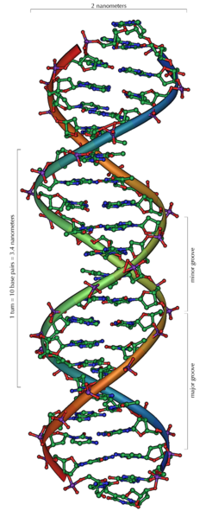
Nitrogen Cycle
Makes up DNA & proteins (muscle function).
Help plants grow.
Where Nitrogen is Found:
Atmosphere (78% is N₂)
Oceans
Organic matter in soil
Lakes, marshes, organisms

Slide 12
Nitrogen Cycle
Earth’s atmosphere is 78% N₂ (nitrogen gas) but most organisms cannot use this nitrogen directly.
Plants can use NO₃⁻ (nitrate) and NH₄⁺ (ammonium).
Nitrogen becomes usable when is “fixed” – pulled from the air and bonded with other elements to make new compounds. This process is called nitrogen fixation.

Slide 13
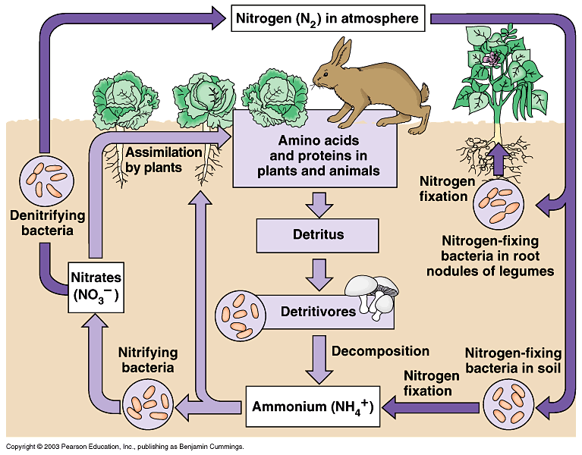
Nitrogen Cycle
1. Nitrogen moves from the atmosphere to the soil or water through nitrogen fixation.
Lightning changes N₂ → NO₃⁻.
Rain washes nitrate into soil.
Bacteria in soil (rhizobium) & cyanobacteria in water
change N₂ → NH₄⁺.

Slide 14
Nitrogen Cycle
2. Nitrogen moves from the soil and water to plants and animals.
Animals get the nitrogen they need by eating plants or other animals that contain nitrogen.
3. Nitrogen moves from plants and animals back to the soil and water.
When organisms die, their bodies decompose bringing the nitrogen into soil or water.

Slide 15
Nitrogen Cycle
4. Nitrogen moves from the soil and water to the atmosphere.
Certain bacteria can convert nitrogen from the soil (NH₄⁺) to nitrates. This process is called nitrification.
NH₄⁺ → NO₂⁻ → NO₃⁻

Slide 16
Nitrogen Cycle
Following nitrification, bacteria and volcanic eruptions change the soil nitrates into N₂ through a process called denitrification.
Nitrogen gas is then released to the atmosphere.
NO₃⁻ → N₂

Slide 17
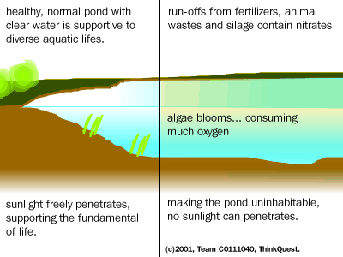
Human Activities & the N Cycle
1. Overfertilization
The use of nitrogen-rich fertilizers and manure can add nitrogen to nearby water systems.
The build up of nitrogen and other nutrients in water is called eutrophication.
The result is that algae and weeds grow rapidly. These can pollute the water.

Slide 18
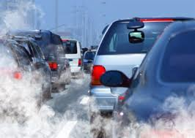
Human Activities & the N Cycle
2. Burning Fossil Fuels
Burning fossil fuels releases nitrogen into the air. This nitrogen eventually falls back to Earth and adds more nitrogen to ecosystems.
NO & NO₂ are byproducts

